Slide 1
SPRING CRUD CLINIC

Slide 2

SIGN IN PAGE

Slide 3
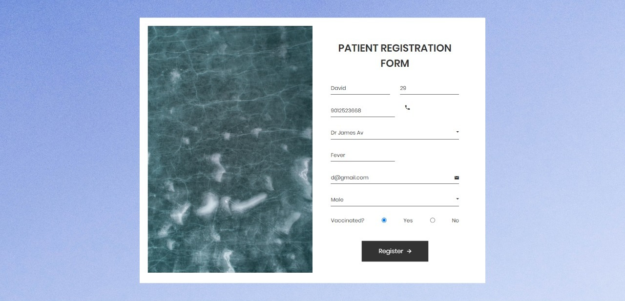
REGISTRATION FORM

Slide 4

DASH BOARD

Slide 5
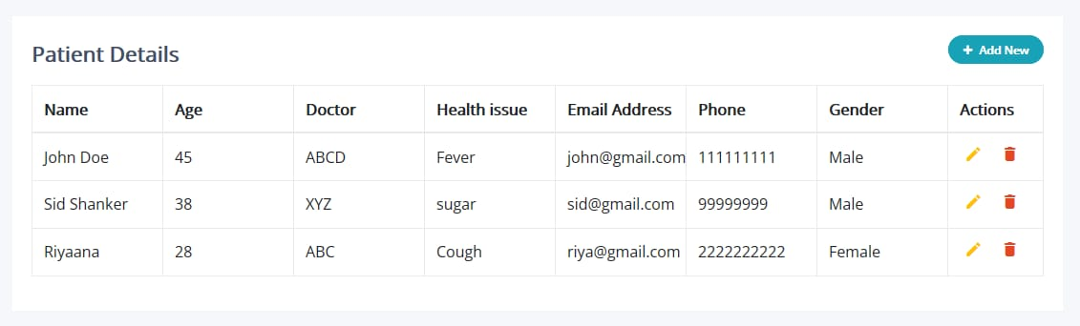
VIEW, UPDATE, DELETE

Slide 6


